Slide 1
Module 2.3
Detour into Unix User IDs and IDs of Unix Processes

Slide 2
A Detour
A few words about Unix User IDs and IDs associated with Unix Processes
Source: CS426 Course at Purdue Univ.

Slide 3
PRINCIPALS AND SUBJECTS
A subject is a program (application) executing on behalf of some principal(s)
A principal may at any time be idle, or have one or more subjects executing on its behalf
What are subjects in UNIX?
What are principals in UNIX?

Slide 4
OBJECTS
An object is anything on which a subject can perform operations (mediated by rights)
Usually objects are passive, for example:
File
Directory (or Folder)
Memory segment
But, subjects can also be objects, with operations
kill
suspend
resume

Slide 5
Basic Concepts of UNIX Access Control: Users, Groups, Files, Processes
Each user account has a unique UID
The UID 0 means the super user (system admin)
A user account belongs to multiple groups
Subjects are processes
associated with uid/gid pairs, e.g., (euid, egid), (ruid, rgid), (suid, sgid)
Objects are files

Slide 6
USERS AND PRINCIPALS
USERS
PRINCIPALS
Unit of Access Control
and Authorization
Real World User
the system authenticates the human user to a particular principal

Slide 7
USERS AND PRINCIPALS
There should be a one-to-many mapping from users to principals
a user may have many principals, but
each principal is associated with an unique user
This ensures accountability of a user's actions
What does the above imply in UNIX?

Slide 8
Organization of Objects
Almost all objects are modeled as files
Files are arranged in a hierarchy
Files exist in directories
Directories are also one kind of files
Each object has
owner
group
12 permission bits
rwx for owner, rwx for group, and rwx for others
suid, sgid, sticky

Slide 9
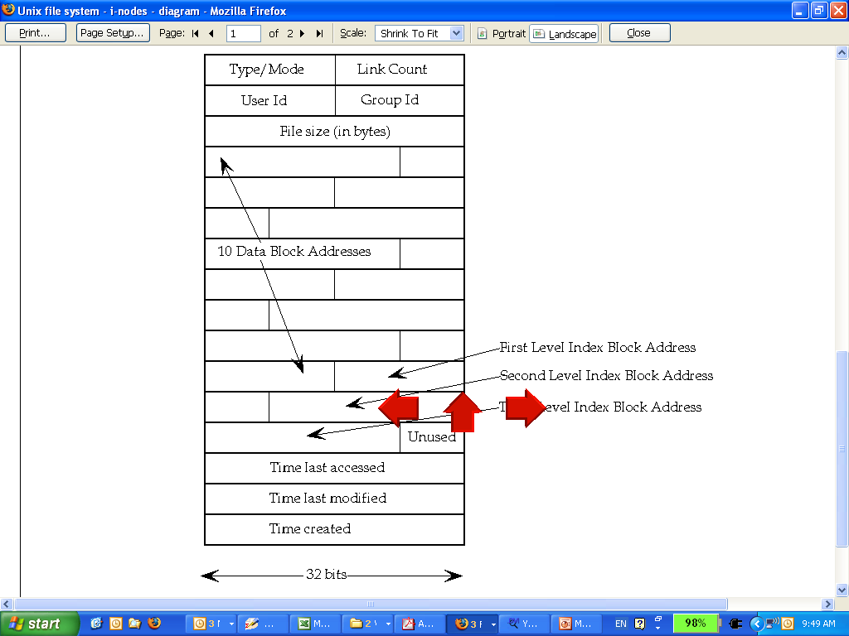
UNIX inodes:
Each file corresponds to an inode

Slide 10
Basic Permissions Bits on Files (Non-directories)
Read controls reading the content of a file
i.e., the read system call
Write controls changing the content of a file
i.e., the write system call
Execute controls loading the file in memory and execute
i.e., the execve system call

Slide 11
Execution of a file
Binary file vs. script file
Having execute but not read, can one run a binary file?
Having execute but not read, can one run a script file?
Having read but not execute, can one run a script file?
Notes:
Having execute but not read, can one run a binary file? Yes.
Having execute but not read, can one run a script file? No.
Having read but not execute, can one run a script file? Yes, by invoking the interpreter

Slide 12
Permission Bits on Directories
Read bit allows one to show file names in a directory
The execution bit controls traversing a directory
does a lookup, allows one to find inode # from file name
chdir to a directory requires execution
Write + execution control creating/deleting files in the directory
Deleting a file under a directory requires no permission on the file
Accessing a file identified by a path name requires execution to all directories along the path

Slide 13
The suid, sgid, sticky bits
 | suid | sgid | sticky bit
non-executable files | no effect | affect locking (unimportant for us) | not used anymore
executable files | change euid when executing the file | change egid when executing the file | not used anymore
directories | no effect | new files inherit group of the directory | only the owner of a file can delete

Slide 14
Some Examples
What permissions are needed to access a file/directory?
read a file: /d1/d2/f3
write a file: /d1/d2/f3
delete a file: /d1/d2/f3
rename a file: from /d1/d2/f3 to /d1/d2/f4
…
File/Directory Access Control is by System Calls
e.g., open(2), stat(2), read(2), write(2), chmod(2), opendir(2), readdir(2), readlink(2), chdir(2), …

Slide 15
The Three sets of permission bits
Intuition:
if the user is the owner of a file, then the r/w/x bits for owner apply
otherwise, if the user belongs to the group the file belongs to, then the r/w/x bits for group apply
otherwise, the r/w/x bits for others apply
Can one implement negative authorization, i.e., only members of a particular group are not allowed to access a file?

Slide 16
Other Issues On Objects in UNIX
Accesses other than read/write/execute
Who can change the permission bits?
The owner can
Who can change the owner?
Only the superuser
Rights not related to a file
Affecting another process
Operations such as shutting down the system, mounting a new file system, listening on a low port
traditionally reserved for the root user

Slide 17
Subjects vs. Principals
Access rights are specified for users (accounts)
Accesses are performed by processes (subjects)
The OS needs to know on which users’ behalf a process is executing

Slide 18
Process User ID Model in Modern UNIX Systems
Each process has three user IDs
real user ID (ruid) owner of the process
effective user ID (euid) used in most access control decisions
saved user ID (suid)
and three group IDs
real group ID
effective group ID
saved group ID

Slide 19
Process User ID Model in Modern UNIX Systems
When a process is created by fork
it inherits all three users IDs from its parent process
When a process executes a file by exec
it keeps its three user IDs unless the set-user-ID bit of the file is set, in which case the effective uid and saved uid are assigned the user ID of the owner of the file
A process may change the user ids via system calls

Slide 20
The Need for suid/sgid Bits
Some operations are not modeled as files and require user id = 0
halting the system
bind/listen on “privileged ports” (TCP/UDP ports below 1024)
non-root users need these privileges
File level access control is not fine-grained enough
System integrity requires more than controlling who can write, but also how it is written

Slide 21
Security Problems of Programs with suid/sgid
These programs are typically setuid root
Violates the least privilege principle
every program and every user should operate using the least privilege necessary to complete the job
Why violating least privilege is bad?
How would an attacker exploit this problem?
How to solve this problem?

Slide 22
Changing effective user IDs
A process that executes a set-uid program can drop its privilege; it can
drop privilege permanently
removes the privileged user id from all three user IDs
drop privilege temporarily
removes the privileged user ID from its effective uid but stores it in its saved uid, later the process may restore privilege by restoring privileged user ID in its effective uid

Slide 23
Access Control in Early UNIX
A process has two user IDs: real uid and effective uid and one system call setuid
The system call setuid(id)
when euid is 0, setuid set both the ruid and the euid to the parameter
otherwise, the setuid could only set effective uid to real uid
Permanently drops privileges
A process cannot temporarily drop privilege
Ref: Setuid Demystified, In USENIX Security ‘ 02

Slide 24
System V
Added saved uid & a new system call
The system call seteuid
if euid is 0, seteuid could set euid to any user ID
otherwise, could set euid to ruid or suid
Setting to ruid temporarily drops privilege
The system call setuid is also changed
if euid is 0, setuid functions as seteuid
otherwise, setuid sets all three user IDs to real uid

Slide 25
BSD
Uses ruid & euid, change the system call from setuid to setreuid
if euid is 0, then the ruid and euid could be set to any user ID
otherwise, either the ruid or the euid could be set to value of the other one
enables a process to swap ruid & euid

Slide 26
Modern UNIX
System V & BSD affect each other, both implemented setuid, seteuid, setreuid, with different semantics
some modern UNIX introduced setresuid
Things get messy, complicated, inconsistent, and buggy
POSIX standard, Solaris, FreeBSD, Linux

Slide 27
Suggested Improved API
Three method calls
drop_priv_temp
drop_priv_perm
restore_priv
Lessons from this?
Psychological acceptability principle
“human interface should be designed for ease of use”
the user’s mental image of his protection goals should match the mechanism

Slide 28
Readings for This Lecture
Wiki
Filesystem Permissions
Other readings
UNIX File and Directory Permissions and Modes
http://www.hccfl.edu/pollock/AUnix1/FilePermissions.htm
Unix file permissions
http://www.unix.com/tips-tutorials/19060-unix-file-permissions.html

